Slide 1
Be part of CSA! Training on Community Supported Agriculture MODULE 2 - Lets start a CSA!

Slide 2
Modular training programme
Module 1
CSA basics
Module 2
Let’s start a CSA!
Module 3
Community builiding and communication
Module 4
On a CSA farm - live

Slide 3
4 essential features of CSAs
PARTNERSHIP
CSA is based on a partnership, usually formalised in a contract between each consumer and the food producer, and characterised by a mutual commitment.

Slide 4
4 essential features of CSAs
LOCAL DIMENSIONS
CSA movement is oriented to the re-localisation of the food production.

Slide 5
4 essential features of CSAs
SOLIDARITY
CSAs are based on solidarity between producers and consumers.
This solidarity has at least 2 dimensions:
sharing the risks and benefits of a local food system
a fair payment of the farm work.

Slide 6
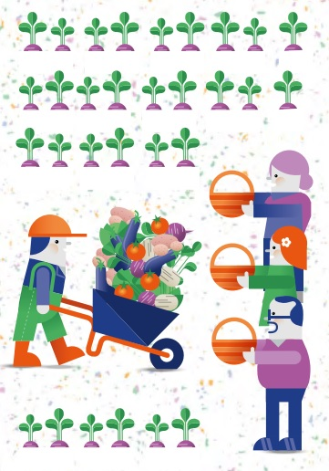
4 essential features of CSAs
PRODUCER-CONSUMER
TANDEM
CSA partnerships are based on direct person-to-person contact and trust, with no intermediary and hierarchy.

Slide 7
Limits & benefits of CSAs
LIMITS FOR THE CONSUMERS
Limited choice of produces – equal shares of the harvest.
Picking up the weekly basket.
Payment in advance and sharing risks of organic farming.
Volunteering for distribution and/or farm activities.

Slide 8
Limits & benefits of CSAs
BENEFITS FOR THE CONSUMERS
Accessing organic and nutritionally rich food
Freshness and taste of a large variety of local products
Substantial information about the food and food production conditions
More accessible food, in terms of organic products prices
Participating and investing in local communities

Slide 9
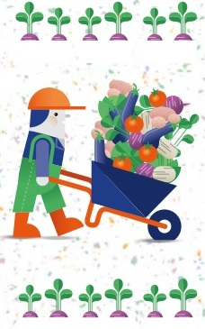
Limits & benefits of CSAs
LIMITS FOR THE PRODUCERS
Risk of lower crops (e.g. pests, severe weather)
Hardships of growing a large variety of organic vegetables
Planning the crops in order to assure continuity of distribution
Low confidence to consumers commitment
Frequent communication actions
Small capital for farm development

Slide 10
Limits & benefits of CSAs
BENEFITS FOR THE PRODUCERS
A secure income
Fairer return for products, covering all production costs, and a fair payment of workers
Increased involvement in the local community. The opportunity to respond directly to consumers’ needs
Less administration activities, assistance in planning and farm activity
Sharing the risks of farming with the
community
Autonomy in land management.
More spare time

Slide 11
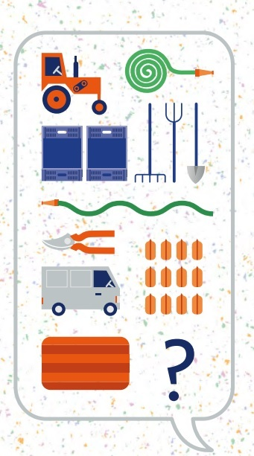
Let’s start a CSAs!
PREPARATORY PHASE
Producer's or consumer's initiative for matching needs: find your first partner (a farmer or a consumer)
Help to form the core group of consumers
Discuss variety of the products and quantities - the decision is taken together by consumers and producer
Define the budget. This should account for all the costs (labour, seeds, organic fertilizators, energy, transportation, investments etc.)

Slide 12
Let’s start a CSAs!
IMPLEMENTATION PHASE
Adopt the budget in a larger meeting of partners
Prepare the contract (if it is the case).
Advertise the partnership
(For consumers) Monitor farm activity, organise regular visits to the farm.
Organise weekly distributions

Slide 13
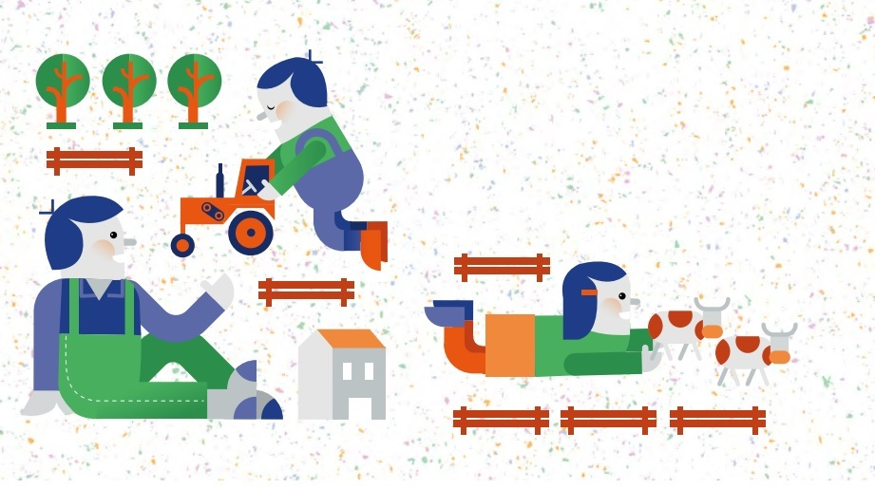
Meanwhile, spend as much quality time as you can on the farm!

Slide 14
Tools used in starting a CSA
Questionnaire to evaluate the farm
Budget
Planning of the distributions (timetable)
Crop planner
Contract and CSA Charter
Advertising materials: flyers, poster, invitations, social media (facebook, twiter etc.)

Slide 15
Thank you for your attention!
Be part of CSA is a multinational project carried out by TVE (Hungary), PRO-BIO LIGA (Czech Republic), CRIES (Romania) and URGENCI (France).
Project website:
urgenci.net/actions/be-part-of-csa
This project has been funded with support from the European Community within Erasmus+ programme. The sole responsibility for this material lies with the author. The Commission and the Agency cannot be held responsible for any use, which may be made of the information contained therein.

